Slide 1
EXPLORING ZOMATO DATASETS-CHENNAI
-Sharanya.S

Slide 2
INTRODUCTION
CHENNAI is the capital of TamilNadu. It is one of the most important metros in India. The population of Chennai is around 70.9 lakhs. The region around Chennai has served as an important administrative, military, and economic centre for many centuries.Chennai is located on the south–eastern coast of India in the north–eastern part of Tamil Nadu on a flat coastal plain known as the Eastern Coastal Plains.attracts many visitors either as tourists or as part of its large workforce. The vast majority claim Chennai is one of the best cities in India.
Its rich and vibrant culture is reflective of its varied food palate. The capital of Tamil Nadu has a wide array of street foods.There are many restaurants here, of varied cuisines (Chinese , Italian , French etc.,).
So as part of this project , we will list and visualise all major parts of Chennai

Slide 3
OBJECTIVE
Possible questions that can be asked are as follows:
WHAT ARE THE:
1.Highest rated resturants in top 10 locality of Chennai?
2.Worst rated resturants in top 10 locality of Chennai?
3.Top 10 most voted restaurant in Chennai?
4.Most lowest votes in top 10 locality of Chennai?
5.highest number of Restaurant available in a Locality - Chennai?
6.lowest number of Restaurant in a Locality - Chennai?
7.BEST places for North Indian Cuisine in Chennai?
8.WORST places for North Indian Cuisine in Chennai?

Slide 4
DATA
For this project we need the following data :
Chennai Resturants data that contains list Locality, Resturant name,Rating along with their latitude and longitude.
Data source : Zomato kaggel dataset
Description : This data set contains the required information. And we will use this data set to explore various locality of new delhi city. Nearby places in each locality of new delhi city.
Data source : Fousquare API
Description : By using this api we will get all the venues in each neighborhood.

Slide 5
RESULTS!

Slide 6
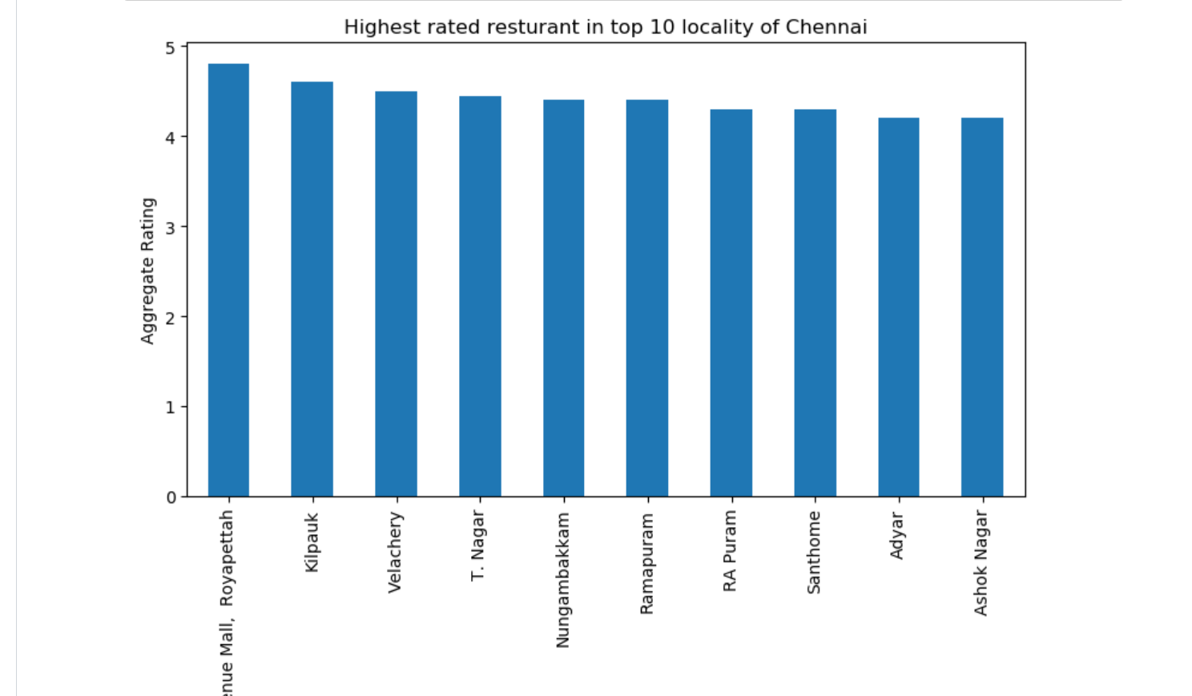

Slide 7
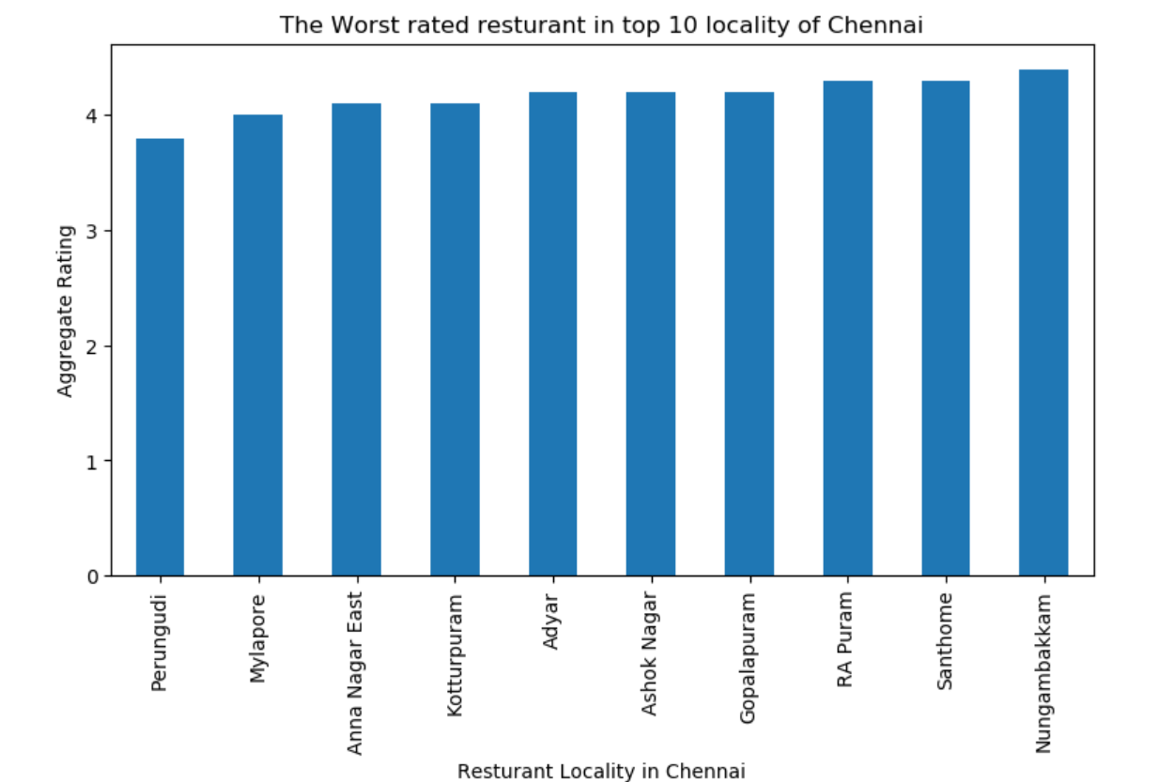

Slide 8
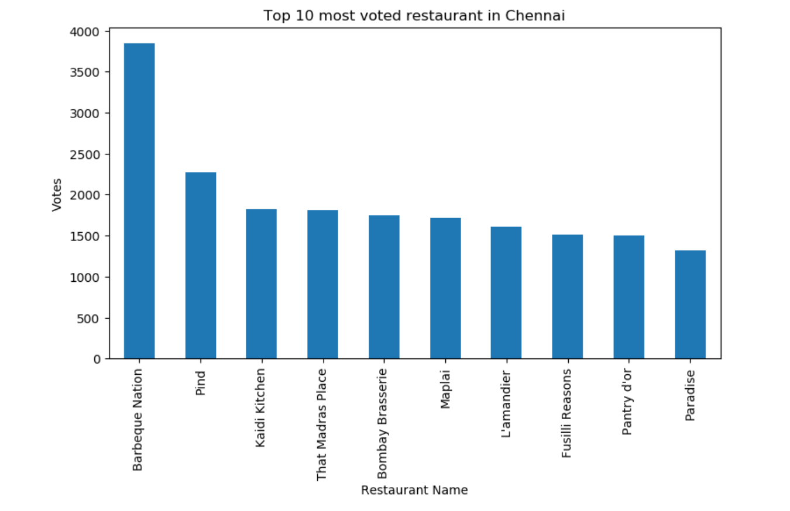

Slide 9
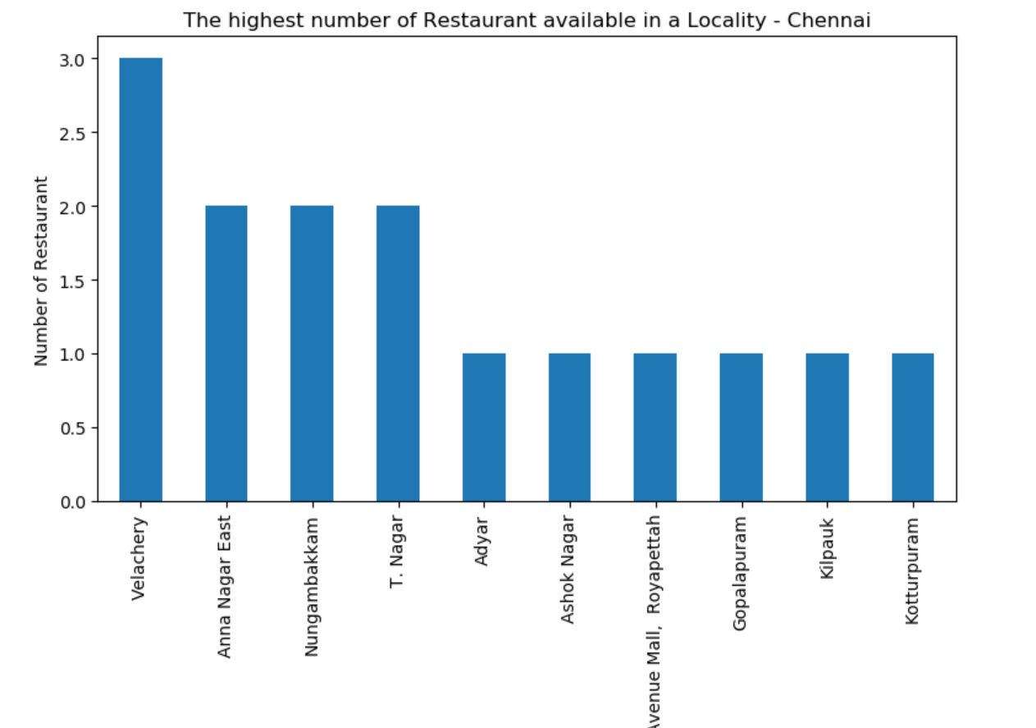

Slide 10
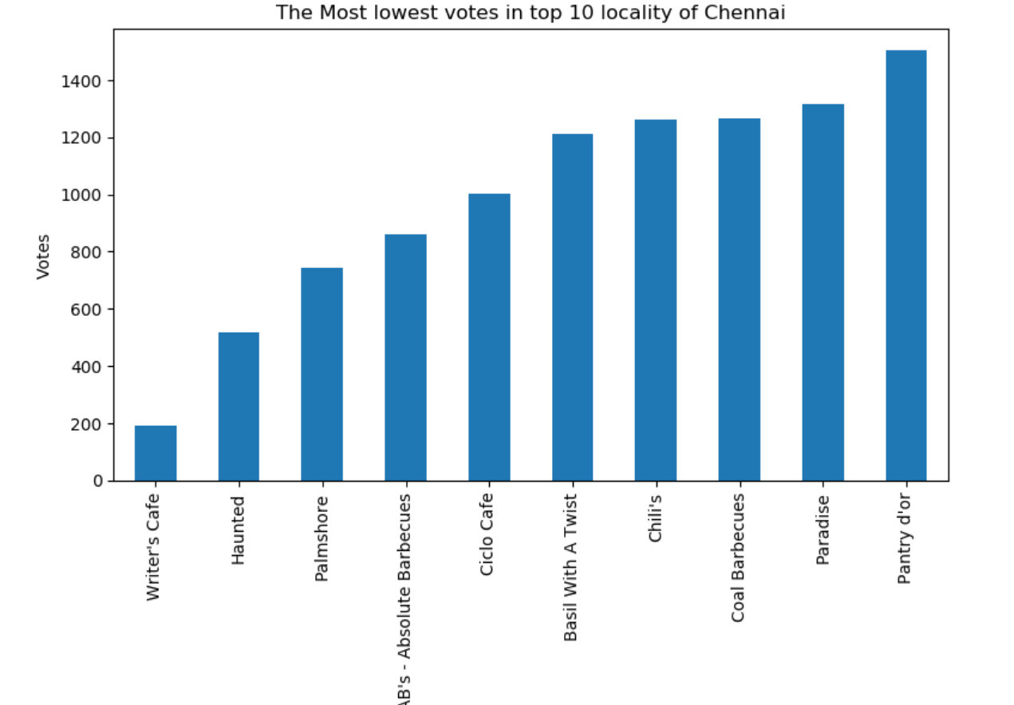

Slide 11
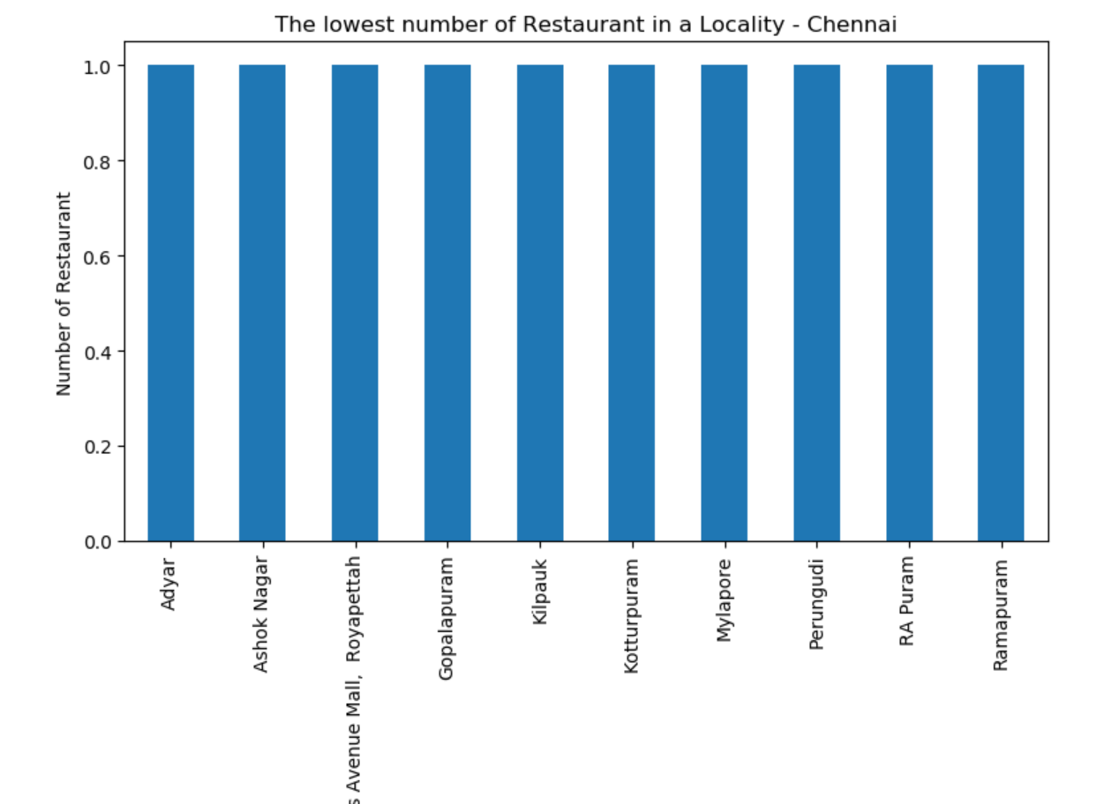

Slide 12
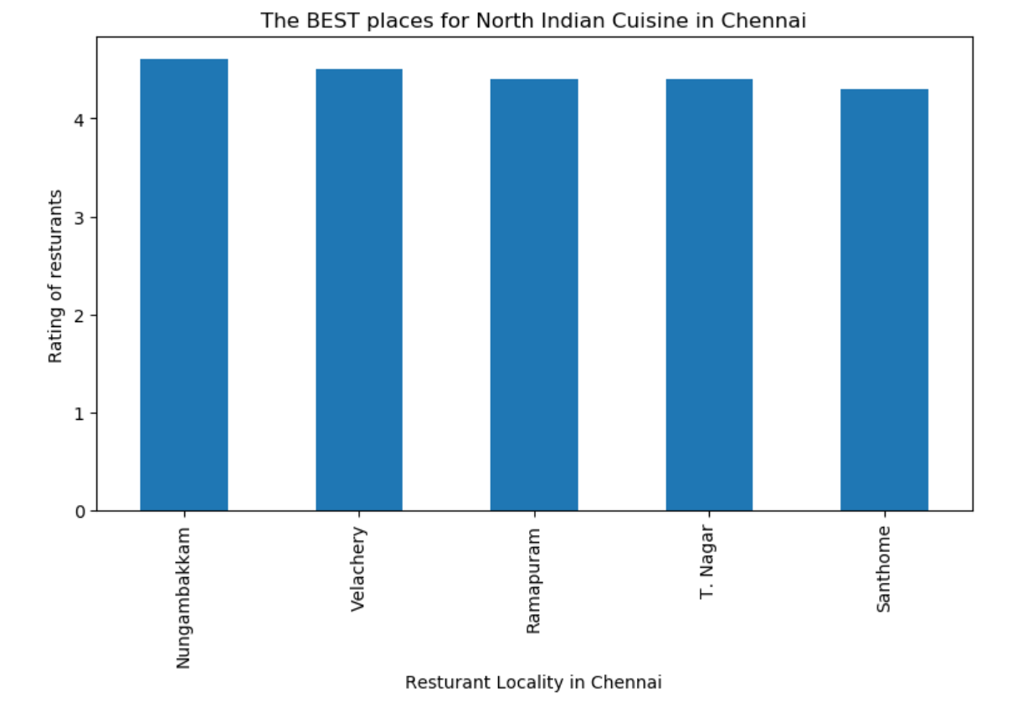

Slide 13
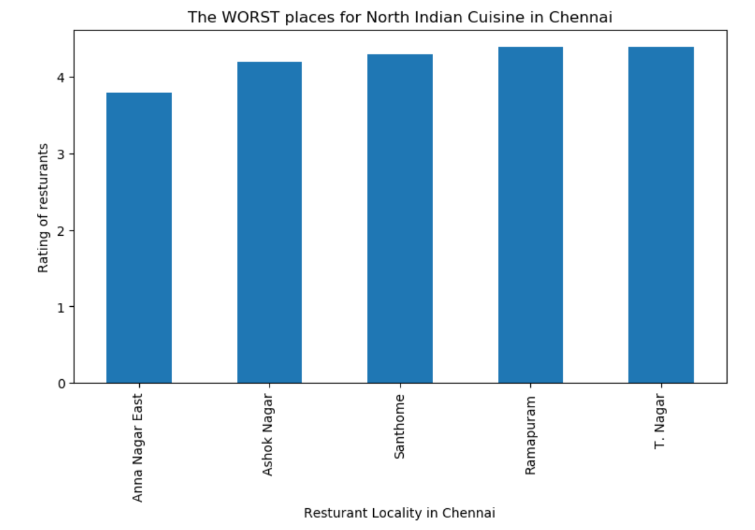

Slide 14
CLUSTERS 1&2

Slide 15
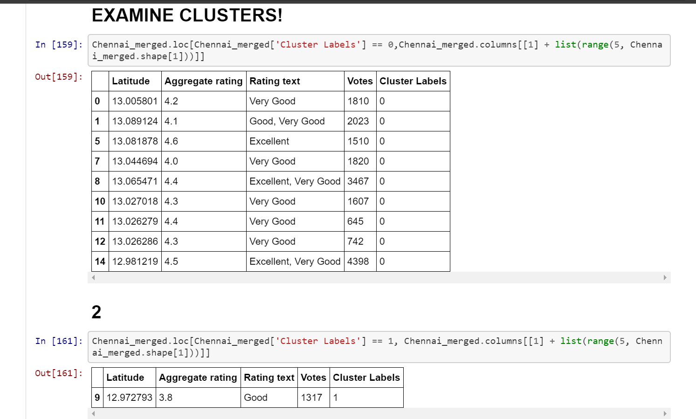

Slide 16
CLUSTERS 3,4&5

Slide 17
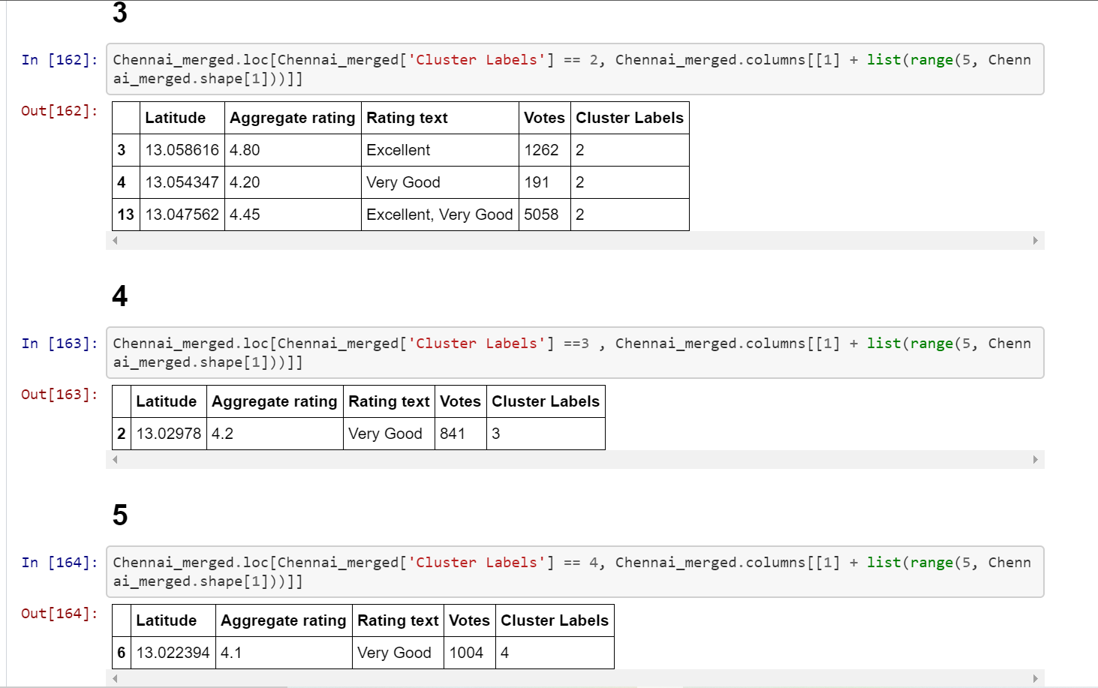

Slide 18
CONCLUSIONS
Restaurants in the Express Avenue Mall,Royapettah are the highest rated.
Restaurants in Perungudi are poorly rated.
Barbecue Nation has the highest votes.
Writer’s Café hasthe lowest votes.
Velachery has the highest number of restaurants.
Nungambakkam is the best place for North Indian Cuisine.
Anna Nagar East is the worst place for North Indian Cuisine.

